Slide 1
Ocean Resources
Lecture 25
Fundamentals of Earth Resources
The co-evolution of science, technology and law
L. M. Cathles
2017

Slide 2
Ocean Resources is a new story
Scientifically
Legally
environmentally
This lecture tells some of this story from a personal perspective
One professional lifetime

Slide 3
Scientific History
1915 Origin of the Continents and Oceans
1958 International Geophysical Year
Seafloor spreading
~1965 Appreciation of Mn Nodule resource
1968 Plate tectonics
Black smokers at 21°N EPR
- VMS ⬄ SMS
Wegner
Hess
Morgan
Ballard and Francheteau

Slide 4
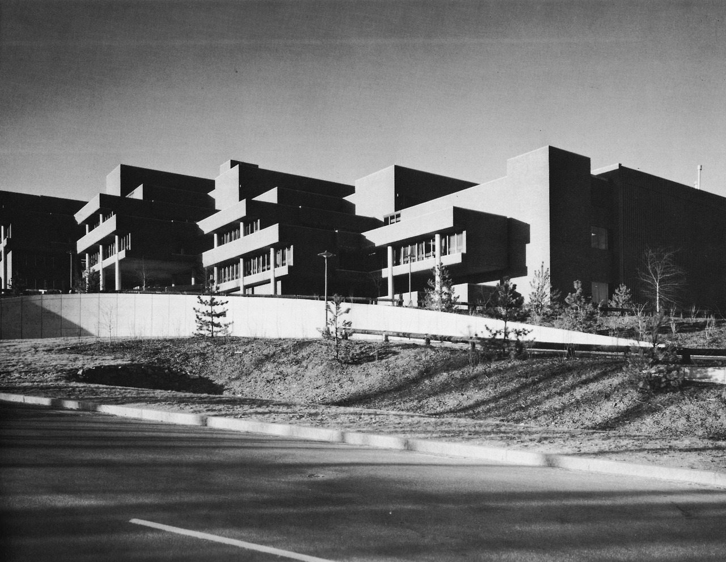
Kennecott’s Ledgemont Laboratory
Kennecott Copper Corp.
Ledgemont Laboratory,
Rt 2 and 128
Lexington, Mass
Mn Nodules
In Situ Cu Leaching
Coal roof stability
Solar Panels
Exploration and recovery (heap leach) research
1971 → 1978

Slide 5
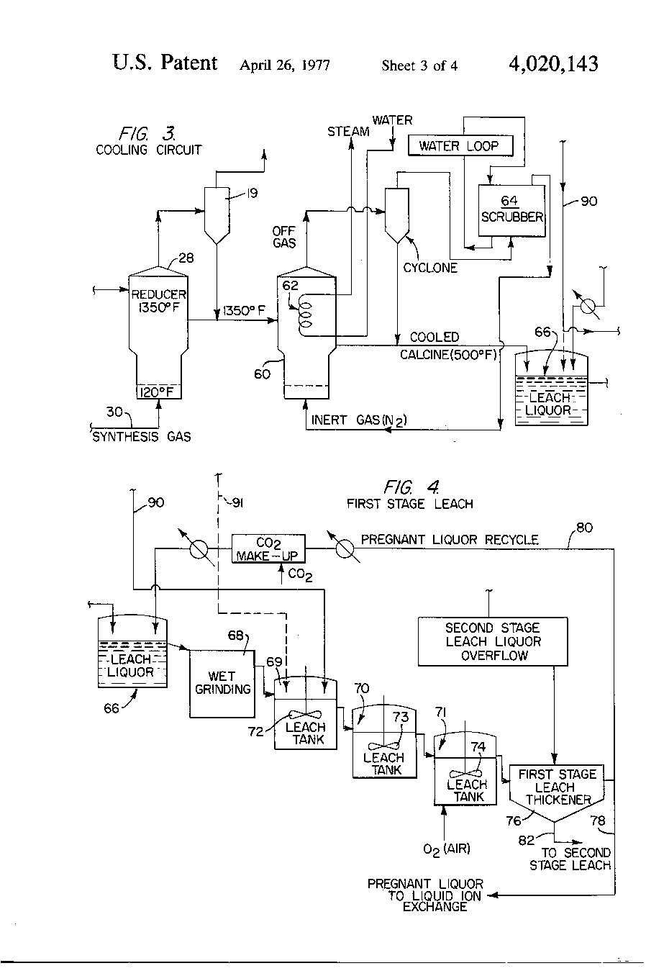
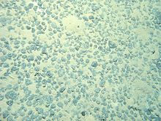
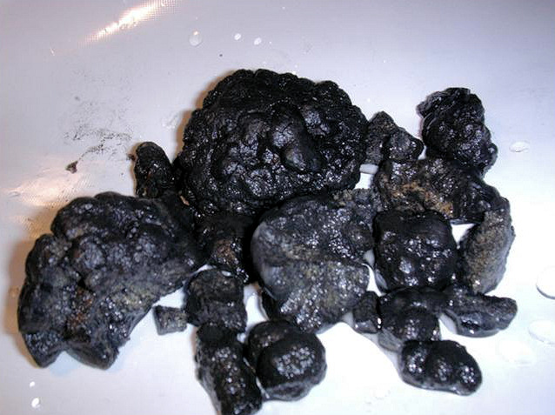
KCC Mn Nodule Project
KCC Processing Patent
Mn Nodules
No Law
Law would follow practice

Slide 6
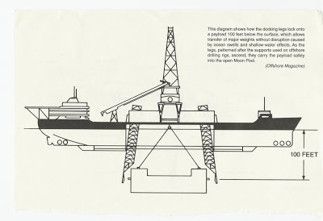
Howard Hughes Nodule Harvester

Slide 7
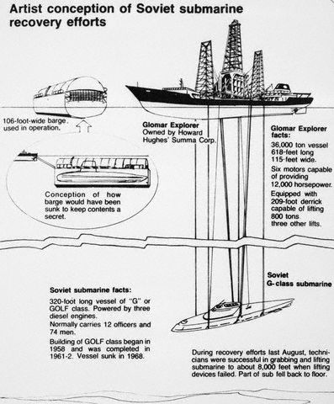
Howard Hughes Nodule Harvester

Slide 8
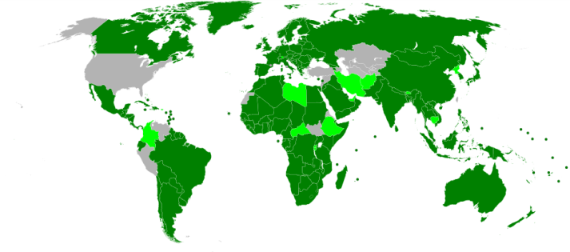
Law of Sea
Customary Law (free oceans except cannon shot distance of few miles)
40’s-50’s Oil made continental shelf of interest
Geneva Convention ‘58- 1964
New post-colonial countries’ concern for control of oil and fisheries interests– reformed LoS
1973→1983→1994 UNCLOS UN Convention on Law of Sea
Avid Pardo (Malta) 3 hr presentation common heritage mankind
Highly political and ideological
Nodules initial focus
JV UDC and Corp not fly
‘77 Kissinger– soln: mixed system
2 sites of equal value
1982 agreed, 60th ratified in April 1994
1994 Implementation agreement (tech transfer, financial problems, veto)
400 articles, 6 languages, variable specificity, today 165 signatory countries
International Tribunal for Law of Sea
Full array of mechanisms (1st advisory, other courts first, Ad Hoc Arbiter if choose)
Other conventions adopting Law of Sea mechanism (Fish Stocks, Archeological objects)
Mn Nodules, SMS, Co Crusts---- evolving process
Precautionary principle- if sci evidence insuff but plausib indic of risk→ must address
5 workplans, 7 exploration contracts polymetalic nodules, 2 expl K SMS, Co crusts nxt
Long process
no
not ratified
yes
resolved

Slide 9
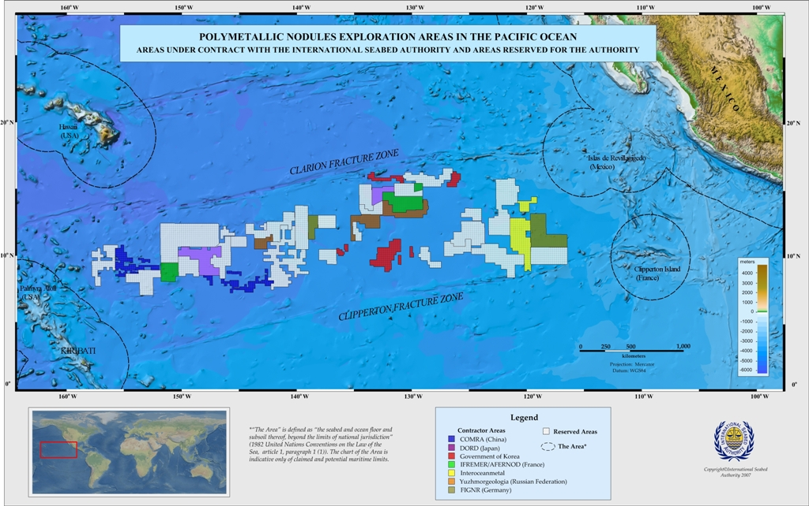

Slide 10
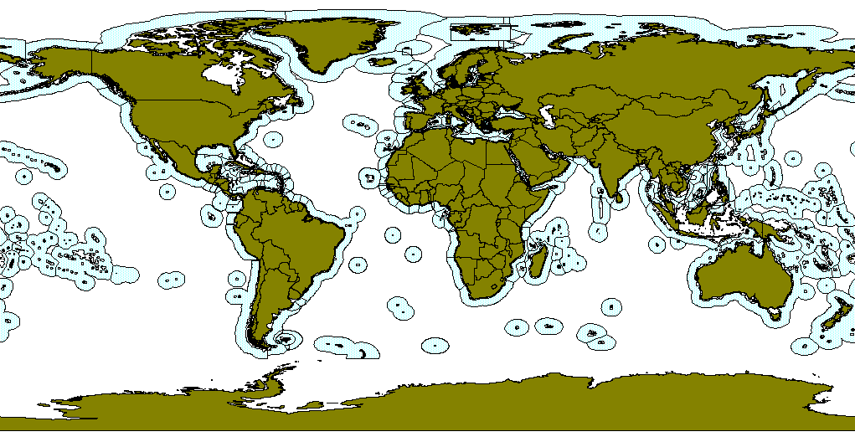
Exclusive Economic Zone

Slide 11
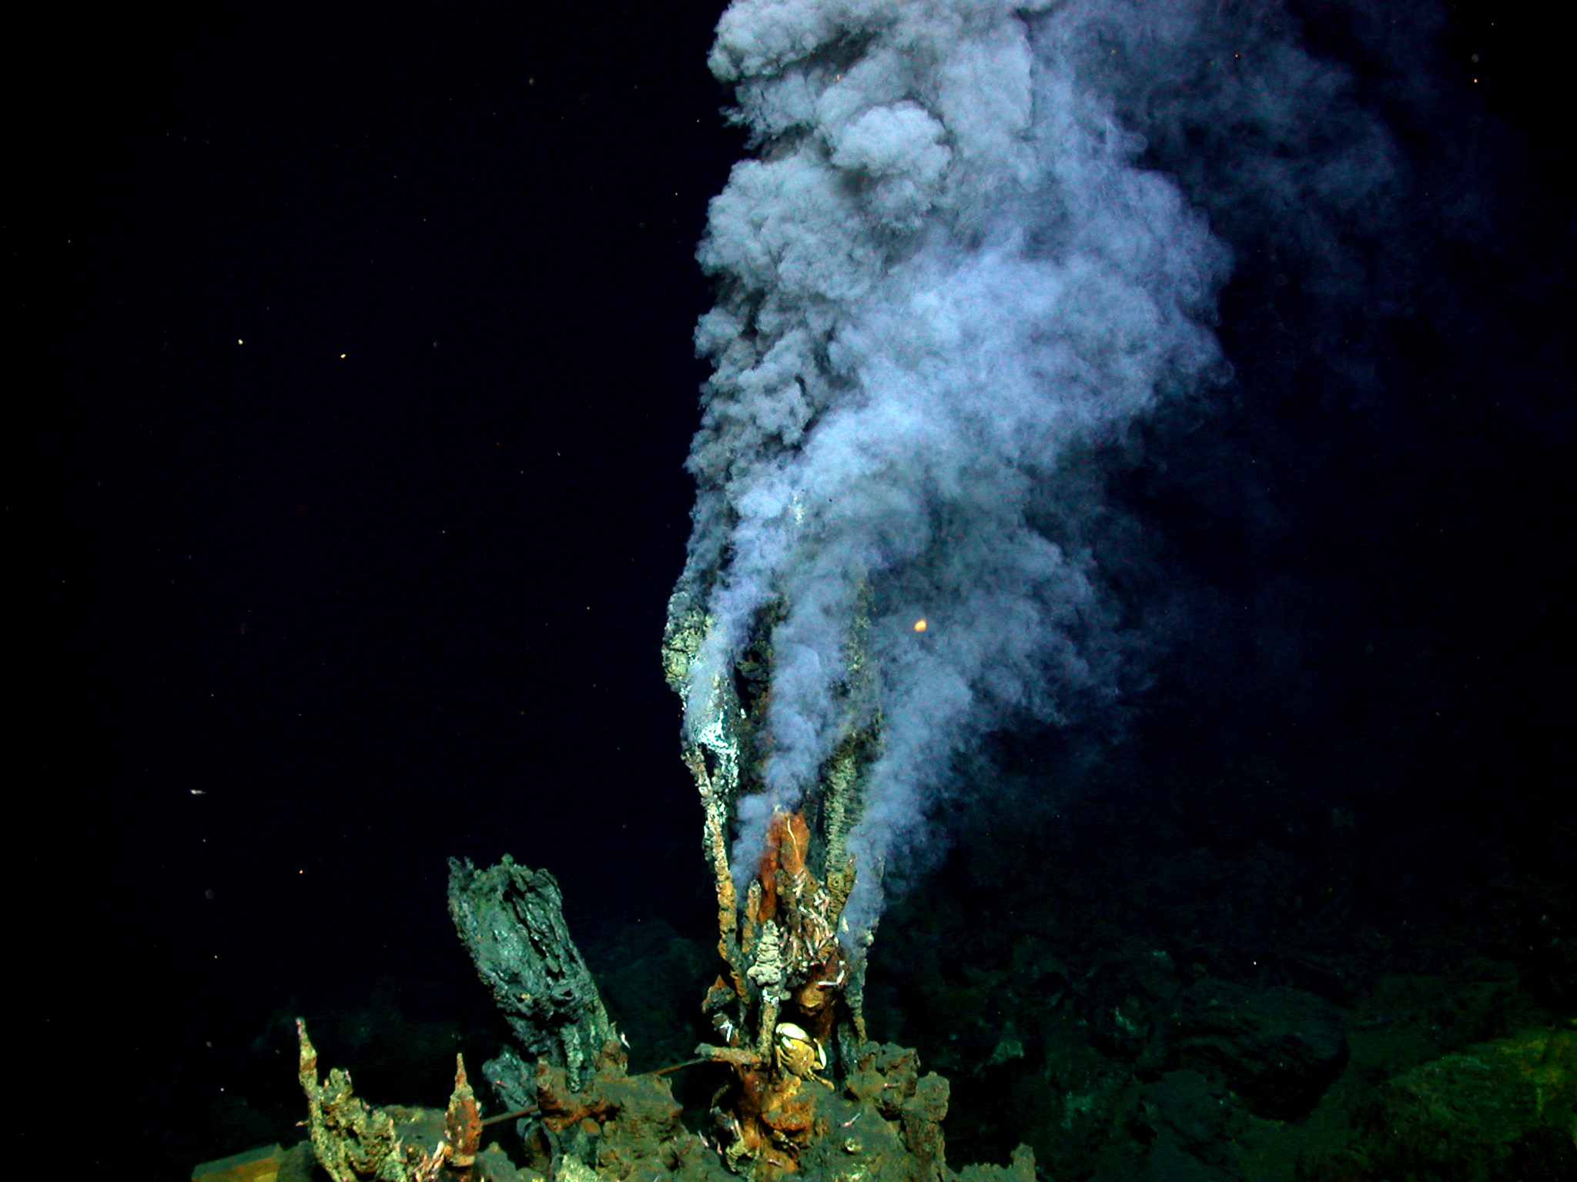
The importance of ocean resources in sustaining humanity over the next millennia and the importance of starting now Keynote in From seafloor hydrothermal systems to the sustainable exploitation of massive sulfide deposits myths and realities of the deep sea Workshop Bergen, Norway May 11, 2015 by Lawrence M. Cathles Cornell University
Cindy van Dover
http://www.eurekalert.org/images/kidsnews/FisherSMOKER.jpg

Slide 12
Questions
Should we mine the sea floor?
When should we start?
Why?

Slide 13
Seafloor exploitation
 | Advantages v. land-based mining | Challenges
Seafloor massive sulfides | Easy to discover Focused in small high grade body No rock waste to remove No waste, tailings, ARD etc. Portable mining equipment Ship to best available treatment facility No people | Resource potential? Seafloor biota Sulfide dispersion Perception National v. international waters Variable and complex ore – treatment issues
Nodules | Extensive resource – high grade and relatively homogeneous No rock to move, no waste Ship to best available treatment facility No people Available to non-resource nations | Selective mining with minimal seafloor disturbance Complex expensive extraction Potential to kill the Mn market – limits value Potential for only one major producer

Slide 14
VMS land-based exploitation
 | Advantages of land-based mining | Challenges
VMS deposits | “Relatively” easy to discover and evaluate – geophysical methods, geological model, 3D data and standard technology Standard open pit or underground mining approach Ore and waste variability established prior to mining Custom built treatment facility Relatively high grade and polymetallic – hedges individual commodity price volatility | May have complex geology – post-formation deformation Have to move and store waste – rock and tailings ARD and other water issues Relatively small bodies – only the largest deposits meet targets for major companies Requires local social license to operate

Slide 15
A bit more on REE
Resources of he sea was discussed in Lecture 8.
Here is a bit more on REE and ocean resources other than copper and zinc,
and a few reminder slides.

Slide 16
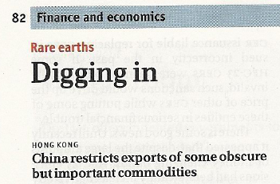
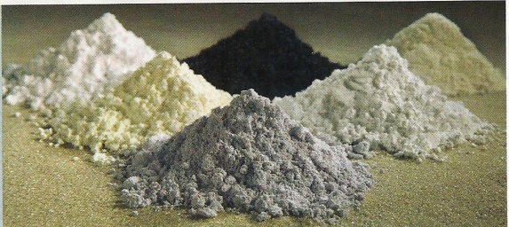
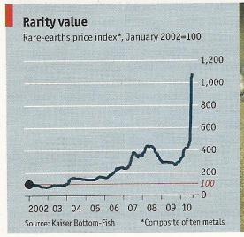
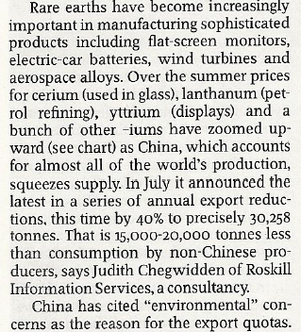
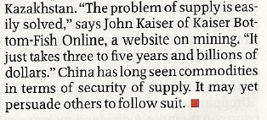
REE
REE+Yt = REY

Slide 17
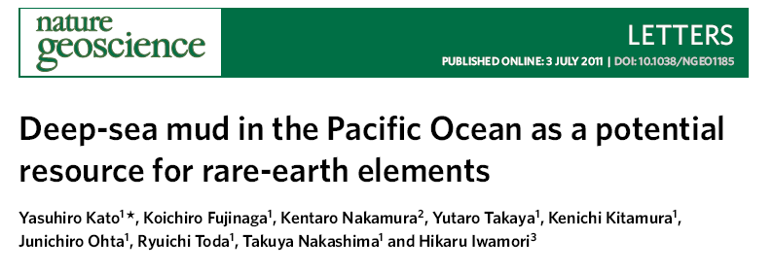
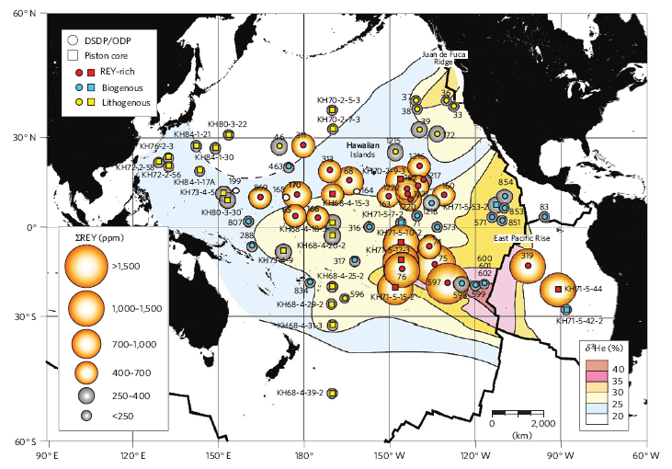
And then…
REY from MOR hydrothermal activity concentrated in Fe-oxyhydroxide sediments could exceed land reserves

Slide 18
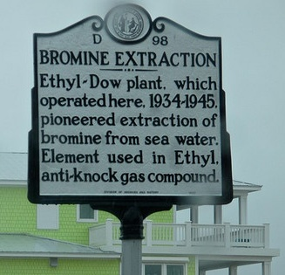
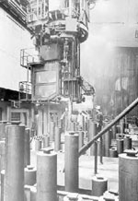
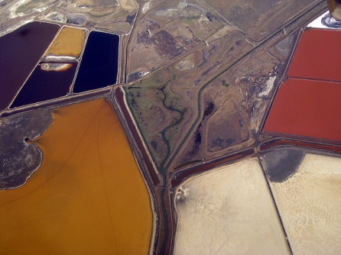
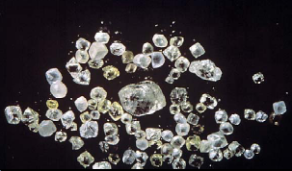
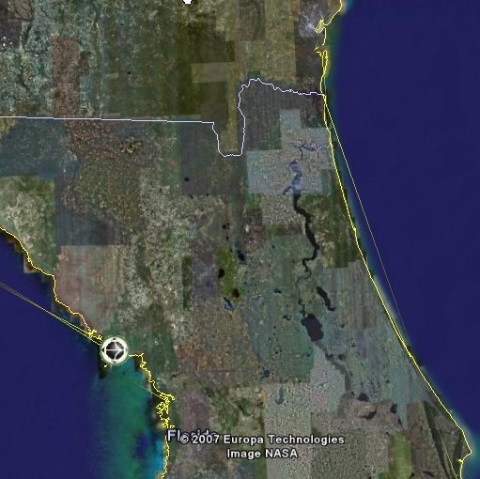
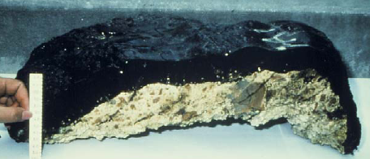
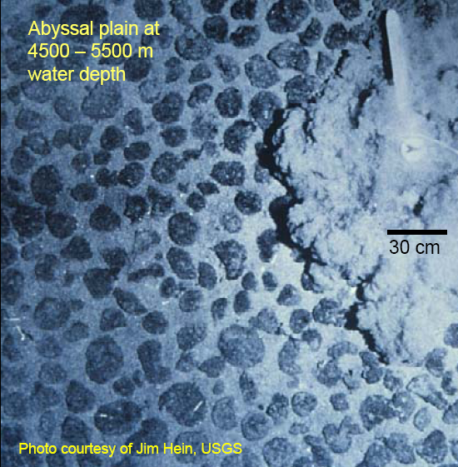
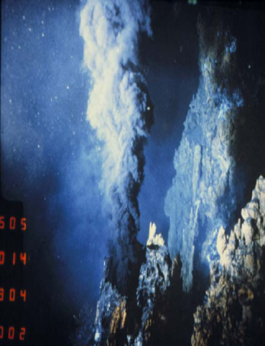
Ocean resources
Dissolved
Salt
Br
Mg
U (3 ppb)
Au (3ppt =$260 trillion, F. Haber)
Placer
Sand and gravel
Diamonds
Ti, Sn, Au, lime
Precipitated
Phosphate
Ferromanganese Crusts
Mn Nodules
SMS
REE
Oil, Gas Hydrates
Shipboard recovery
San Francisco Bay sea salt
Dow Mg Plant
Feeeport, Tx
Diamond placers, Namibia
200 km
largest marine mining (Indonesia)
Mn crusts, Jim Hein USGS
1% Co, Ni, Cu, Mo, PGE, REE, Zr,Te
Mn Nodules
28% Mn
1.4% Ni
1.2% Cu
0.25% Co.
>1500
ppm REY
13°N EPR
Roger Hekinian
MOR oxyhydroxide sediments

Slide 19
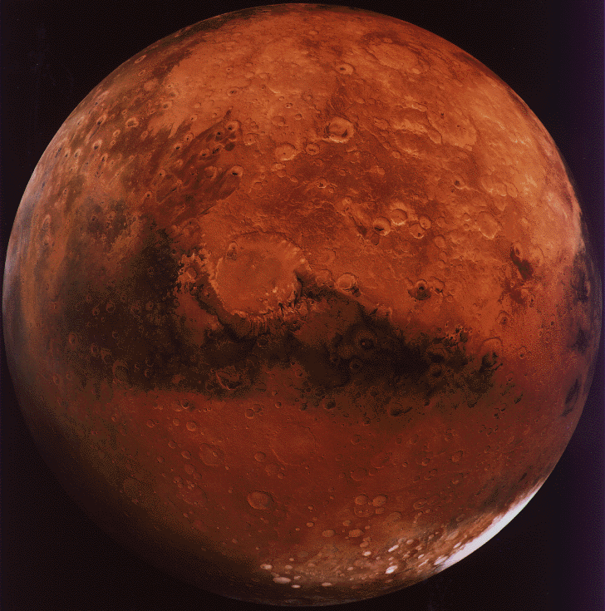
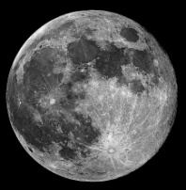
Ocean resources are significant because:
(1) The ocean is a huge area
Earth’s Oceans
Mars
Moon
=
+
Steve Scott

